Slide 1


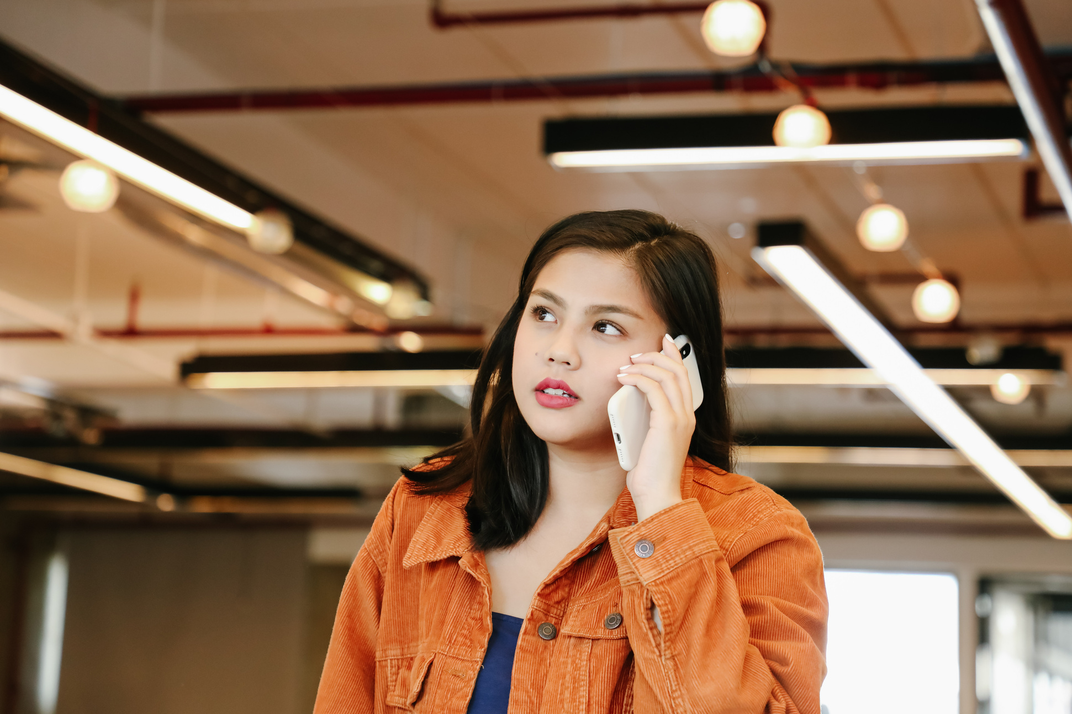
LOCAL REWARD
Turn everyday visits into lasting customer loyalty.
01

Slide 2

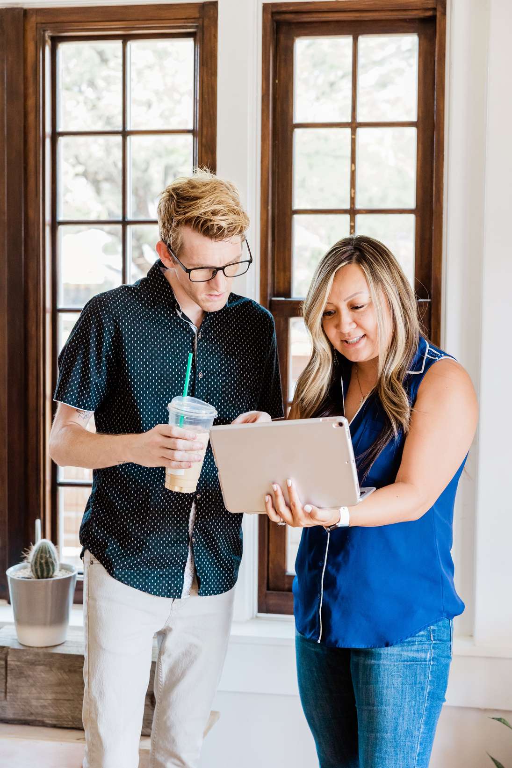
Local businesses struggle to retain customers. Loyalty often goes unrecognized, and many small establishments lack the tools to reward their regulars or engage them digitally.
10

Slide 3

solution
A simple, modern loyalty rewards app. We help local businesses attract repeat visits by offering customizable, digital rewards tailored to their customers.
06

Slide 4
PRODUCT FEATURES
🎯 Customizable Rewards – Set your own loyalty program.
📱 QR Code Check-ins – Easy point collection via scan.
🔔 Push Notifications – Send deals and promotions directly.
📊 Customer Insights – Track behavior and optimize engagement.
👥 Referral Rewards – Let users spread the word.
🌐 Multi-location Support – Great for franchises and chains.
04

Slide 5
HOW IT WORKS
Customers Check In using a QR code or phone number.
Points Accumulate with each visit or purchase.
Rewards Unlock automatically when milestones are reached.

Slide 6
TARGET MARKET
Local Barbershops & Salons Independent operators looking to increase repeat visits and build a loyal client base.
14

Slide 7
MARKET SIZE
300K+ barbershops and salons
600K+ independent restaurants and cafés
$900B+ annual spend across these sectors

Slide 8
Competitors
Feature | Local Loyalty App | Fivestars | Square Loyalty | Toast Loyalty
💈 Tailored for Salons & Barbers | ✅ | ❌ | ❌ | ❌
🍽️ Works for Eateries | ✅ | ✅ | ✅ | ✅
🧾 POS-Independent | ✅ | ❌ | ❌ | ❌
⚡ Easy Setup (<10 mins) | ✅ | ❌ | ❌ | ❌
💸 Affordable Pricing | ✅ | ❌ | ❌ | ❌
📱 Mobile-First Design | ✅ | ✅ | ❌ | ✅
🎯 Simple, Custom Rewards | ✅ | ✅ | ❌ | ❌
Platform | Focus | Weaknesses
Square Loyalty | POS-integrated loyalty for SMBs | Expensive, tied to Square system
Fivestars | Loyalty + CRM for local biz | High fees, complex setup
Belly | Digital punch card system | Limited customization
Toast Loyalty | Restaurant-focused loyalty | Restaurant-only, POS dependent
23

Slide 9

Competitive advantage
Feature | Local Loyalty App | Fivestars | Square Loyalty | Toast Loyalty
💈 Tailored for Salons & Barbers | ✅ | ❌ | ❌ | ❌
🍽️ Works for Eateries | ✅ | ✅ | ✅ | ✅
🧾 POS-Independent | ✅ | ❌ | ❌ | ❌
⚡ Easy Setup (<10 mins) | ✅ | ❌ | ❌ | ❌
💸 Affordable Pricing | ✅ | ❌ | ❌ | ❌
📱 Mobile-First Design | ✅ | ✅ | ❌ | ✅

Slide 10
Project Traction
Tasks
Month 1
Month 2
Month 3
Month 4
Month 5
20+ Local Businesses Onboarded
35% Increase in Repeat Visits
4.7★ Average App Rating
1200+ Rewards Claimed
Patnership in progress
23

Slide 11
Free Plan For small businesses just getting started Up to 50 customer check-ins/month Basic loyalty program features
Pro Plan – $19/month For growing businesses Unlimited check-ins Promotions & push notifications Customer insights & analytics
Business Plus – Custom Pricing For franchises & multi-location brands Advanced tools, integrations Dedicated support Branded experience
Business Model
We charge local businesses a monthly subscription based on usage and features.
23

Slide 12
Go To Market
1. Direct Outreach
In-person visits to salons, barbershops, and eateries
2. Partnerships
Offer co-branded promotions and loyalty initiatives
3. Social Media & Content
Educational content: “How loyalty grows your biz” videos & reels
4. Referral Program
Business-to-business referral bonuses
Customers refer their favorite local spots = bonus points

Slide 13
Our Ask
We’re seeking $150,000 in pre-seed funding to accelerate growth and product development.
Product Enhancements Build advanced features, analytics, and onboarding tools
Marketing & Customer Acquisition Targeted campaigns to onboard 500+ local businesses
Sales & Support Team Hire reps to scale direct outreach and customer success
Technical Infrastructure Ensure smooth performance as we scale usage

Slide 14
Team Members
FATUMA ABDI
ALVIN MWENDWA
CEO
LEAD DEVELOPER
ANNETTE MATATA
ROSE GITHENGU
OPERATIONS MANAGER
SALES

Slide 15




Thank you!
REACH US AT +254772009580
17

